Slide 1


He’s from Spain.
He’s Spanish.

Slide 2


She’s from the USA.
She’s American.

Slide 3

He’s from Canada.
He’s Canadian.

Slide 4

She’s from France.
She’s French.

Slide 5

He’s from Russia.
He’s Russian.

Slide 6

She’s from Poland.
She’s Polish.

Slide 7

He’s from Germany.
He’s German.

Slide 8

She’s from Brazil.
She’s Brazilian.

Slide 9

He’s from Ireland.
He’s Irish.

Slide 10

She’s from Greece.
She’s Greek.

Slide 11

He’s from Great Britain.
He’s British.

Slide 12

She’s from the Czech Republic.
She’s Chech.

Slide 13

He’s from Portugal.
He’s Portuguese.

Slide 14

She’s from Mexico.
She’s Mexican.

Slide 15

He’s from Sweden.
He’s Swedish.

Slide 16

She’s from Australia.
She’s Australian.

Slide 17

He’s from Italy.
He’s Italian.

Slide 18

She’s from China.
She’s Chinese.

Slide 19

He’s from Japan.
He’s Japanese.

Slide 20
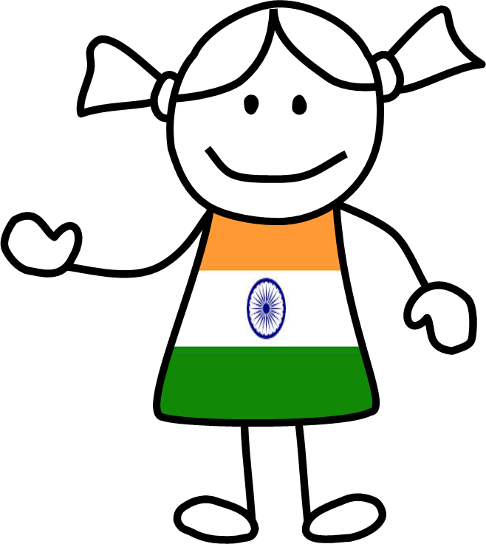
She’s from India.
She’s Indian.

Slide 21

He’s from Egypt.
He’s Egyptian.

Slide 22

She’s from the Netherlands.
She’s Dutch.

